Slide 1





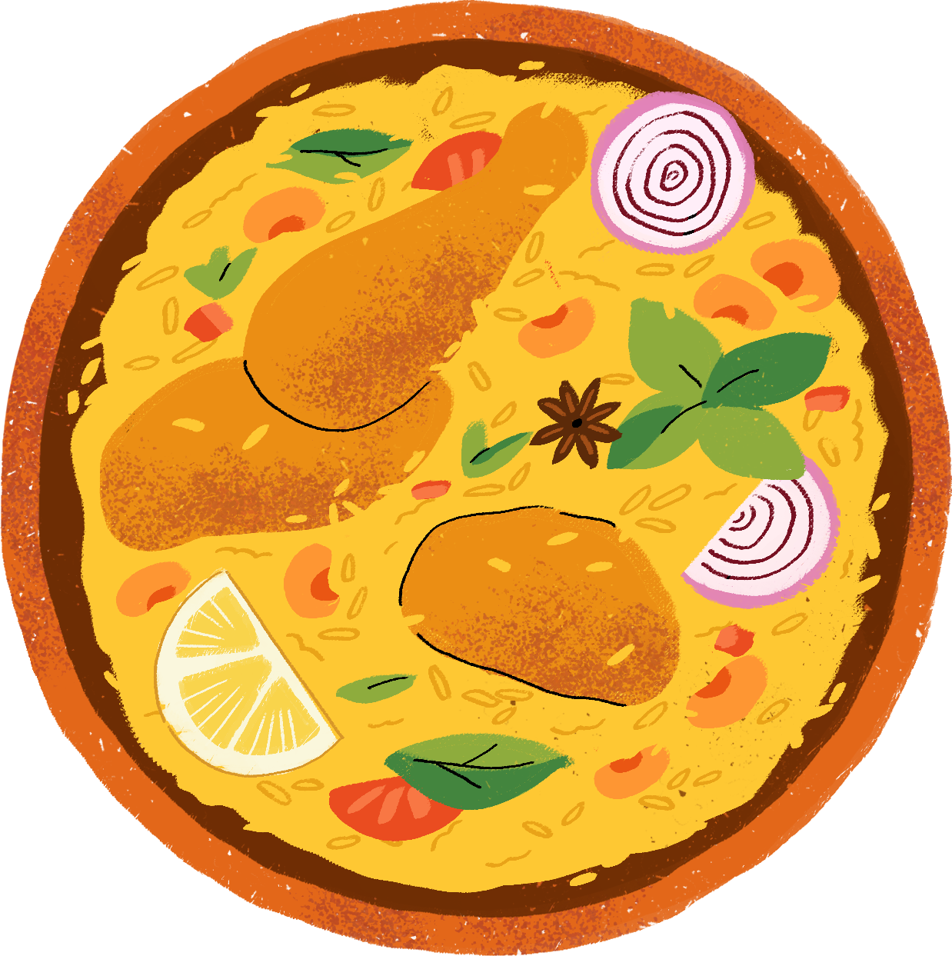

GROUP 1
ChowPal
prd Presentation
Ritujit Chaudhury | Rhea Roy | Prakriti Mishra | Shamsheer Hussain | Nehal Vaiti

Slide 2



NEEDS & CUSTOMER SEGMENTS
1
2
3

Slide 3

BEGINNER COOKS
International Students, Ages 18-28 from India, China, Middle East
Cook 3-5 times/week, budget-conscious
45+ minute travel to ethnic stores
KEY PAIN POINTS:
100% face long travel times
87% abandon dishes due to missing ingredients
73% juggle 3+ apps for one meal
Pain Intensity: 8.2/10
Based on 15 customer interviews

Slide 4
2. CONTENT CREATORS
Graduate students sharing cultural recipes
500-2000 followers, 5+ hrs/week helping others
Want recognition & community impact
CREATOR REWARDS:
Free delivery credits ($5-25)
Featured recipe placement
Cultural expert badges
Performance analytics:
90% interested in platform
Based on 6 creator interviews

Slide 5
3. STORE OWNERS
Family businesses losing 20-30% revenue
Can't afford 25-30% platform fees
No online visibility system
PARTNERSHIP BENEFITS:
Free online storefront
Real-time inventory updates Direct customer reach
Lower fees than competitors
Pain Intensity: 9.1/10
Based on 4 store interviews

Slide 6





Shoppable
Ingredients
PROPOSED SOLUTION
Community
Connection
AI Dietary
Filtering
Creator
Monetization
Local Ethnic Store Partnerships

Slide 7
VISION
ChowPal makes culture cookable.
We connect students with authentic recipes, hard-to-find local ingredients, and a worldwide community of home cooks.
By turning kitchens into bridges across continents, we help students rediscover the flavors, traditions, and comforts of home.
Wherever they are.

Slide 8
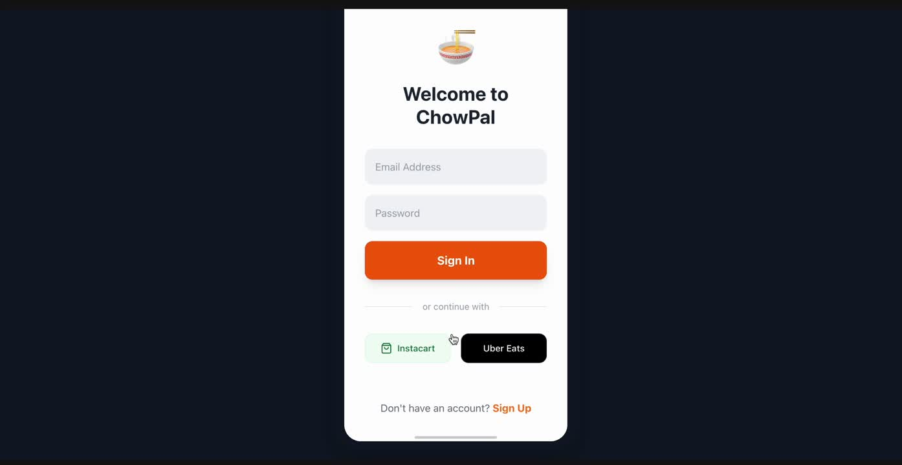
VISUAL STORYBOARD
Beginner Cooks

Slide 9
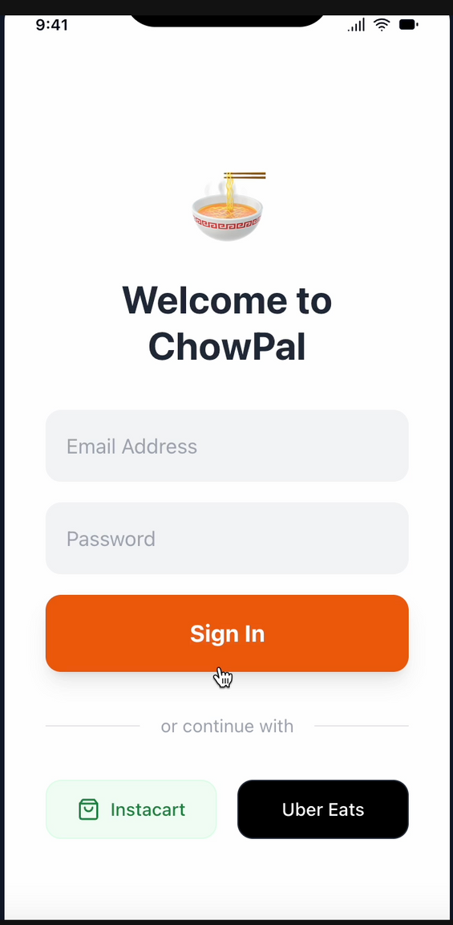
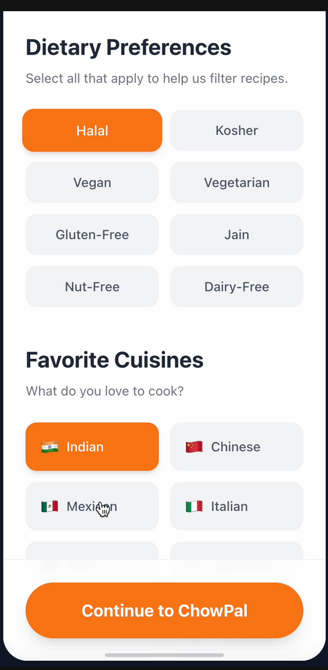
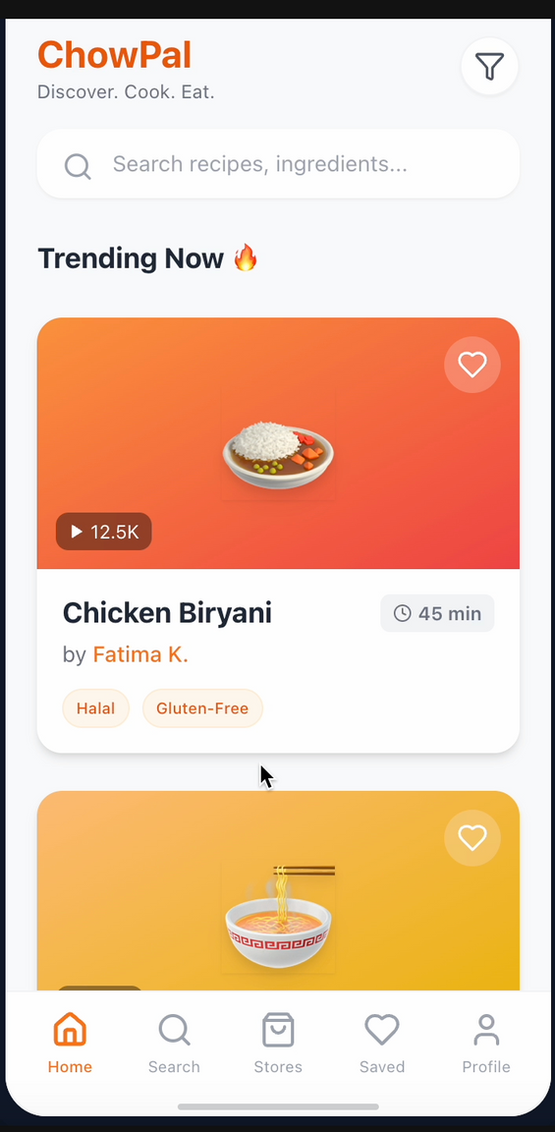
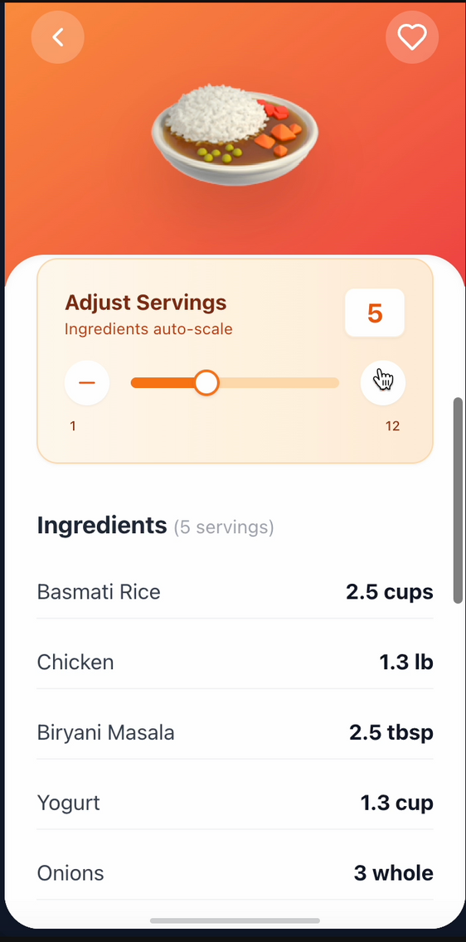
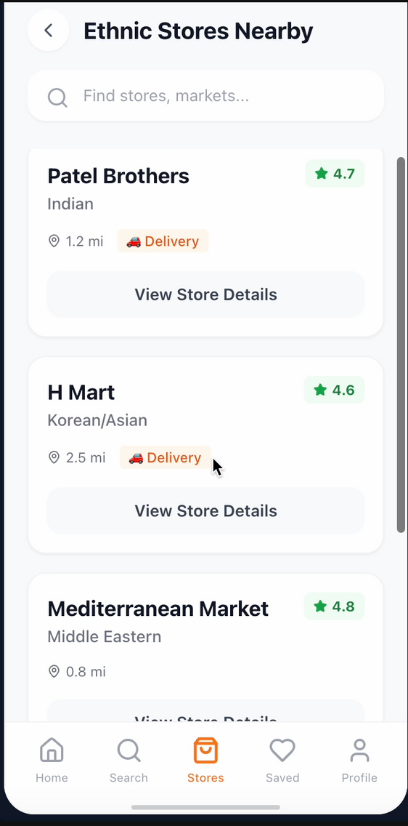
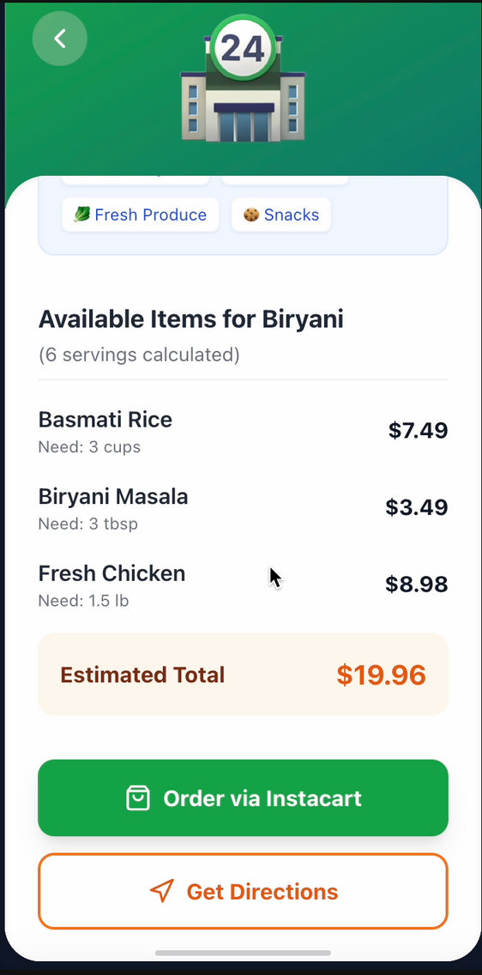

Slide 15
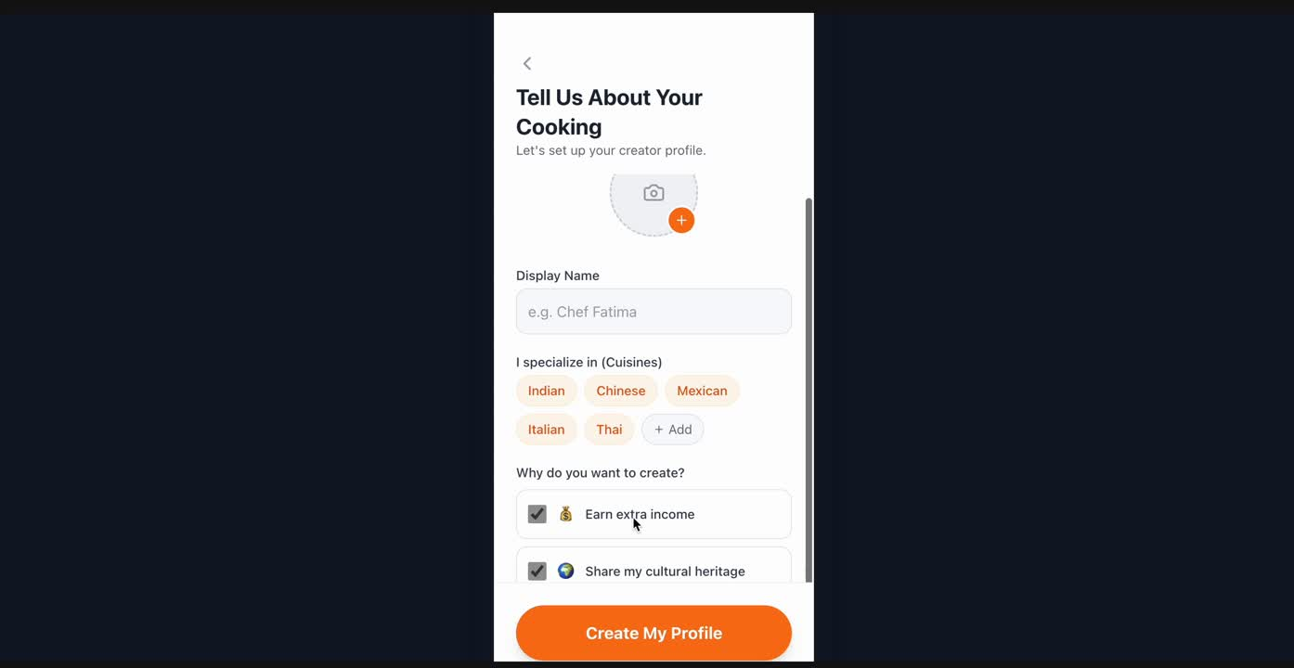
VISUAL STORYBOARD
Content Creators

Slide 16
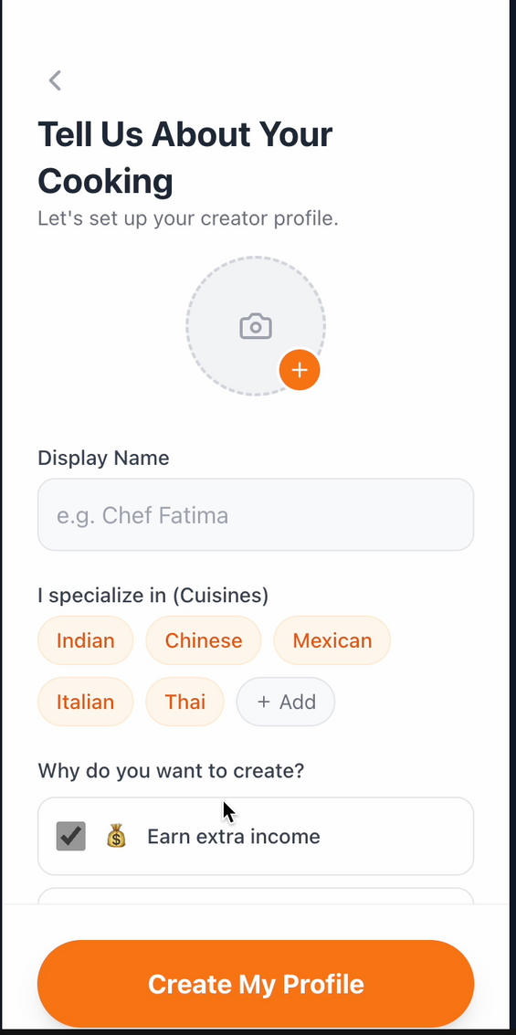
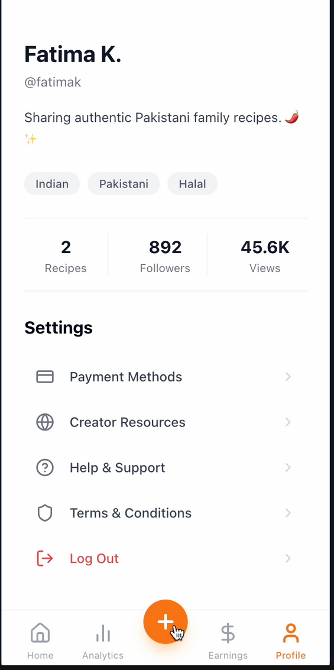
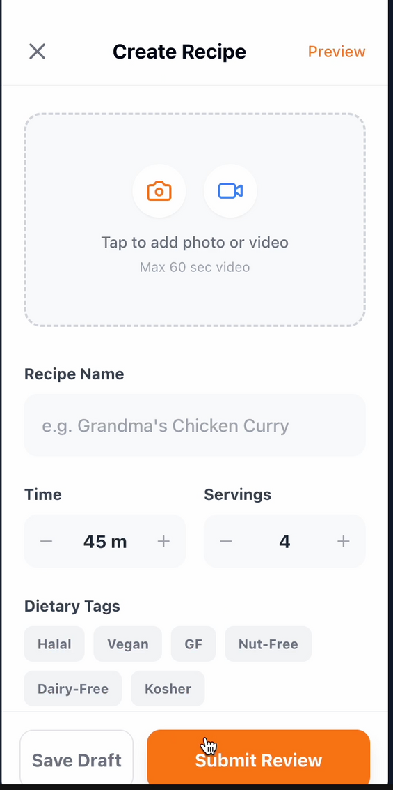
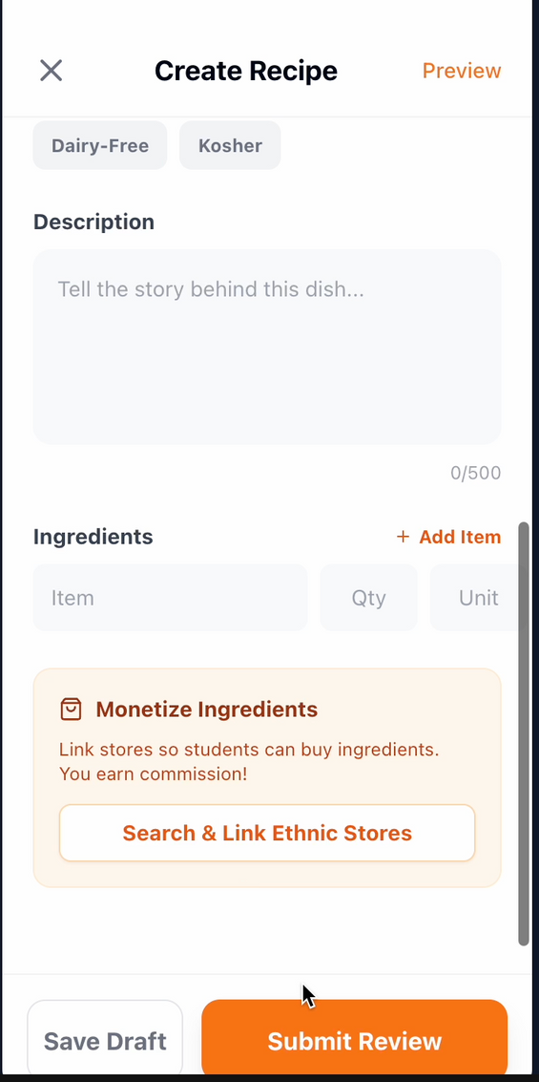
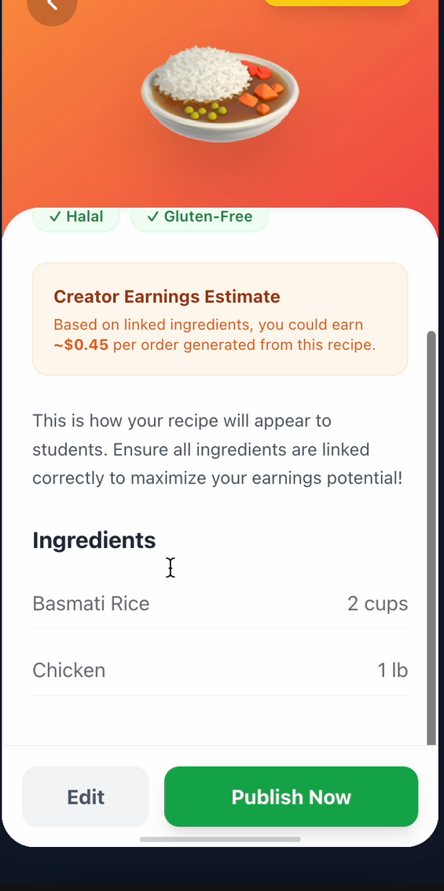
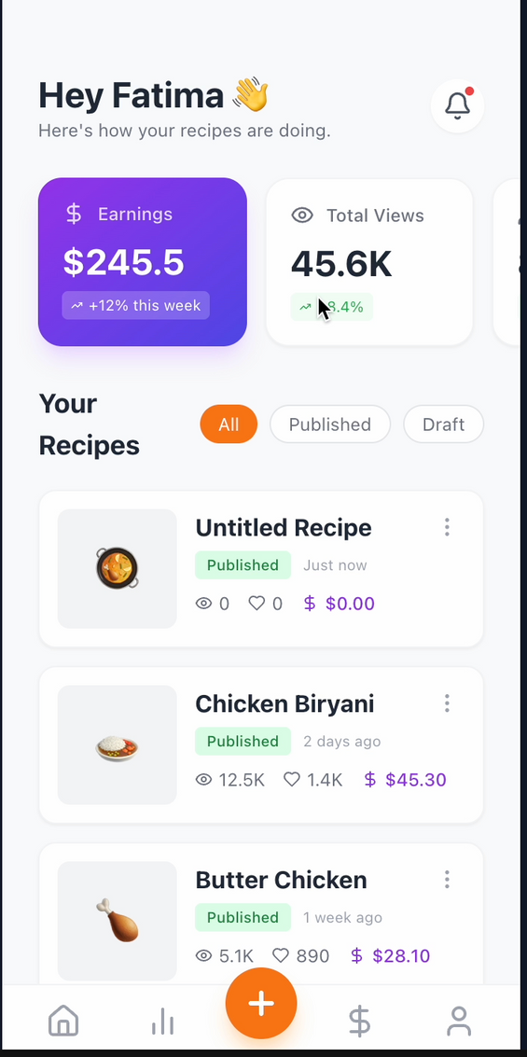

Slide 22
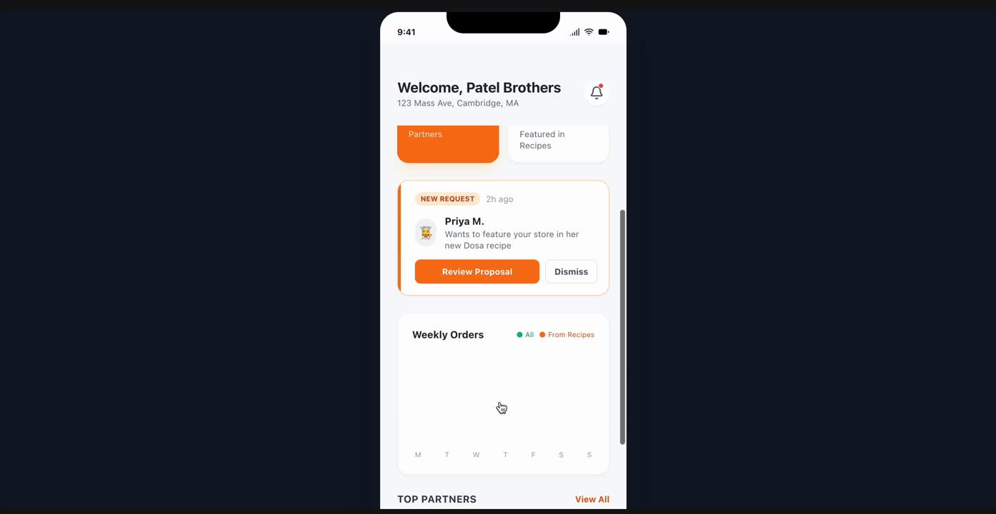
VISUAL STORYBOARD
Store Owners

Slide 23
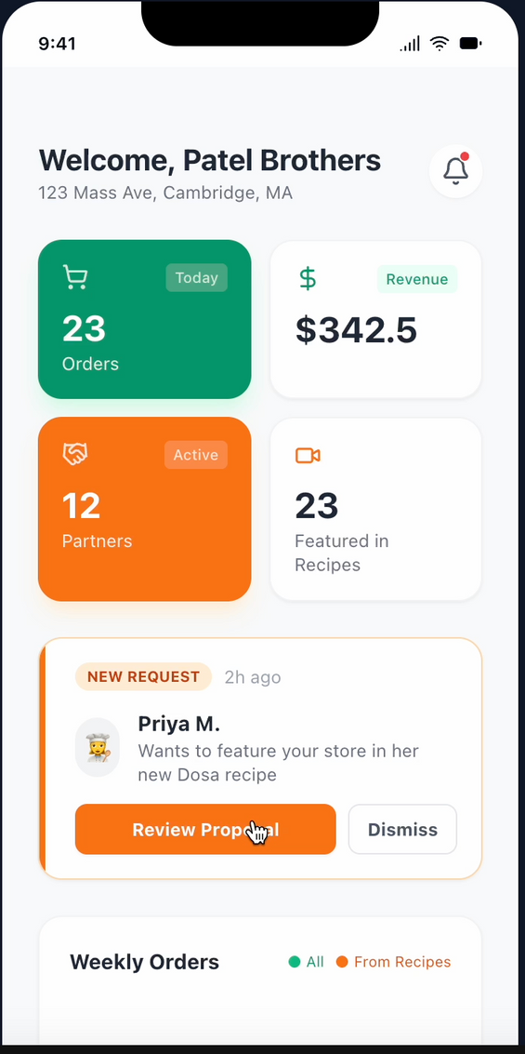
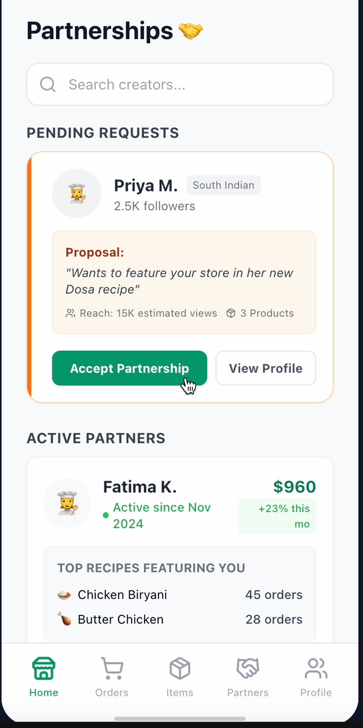
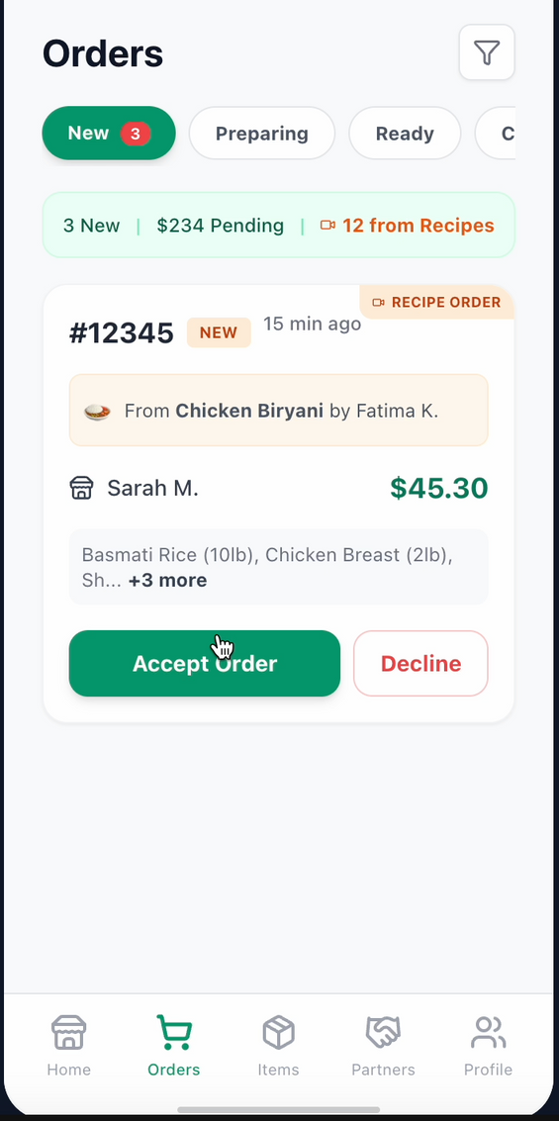
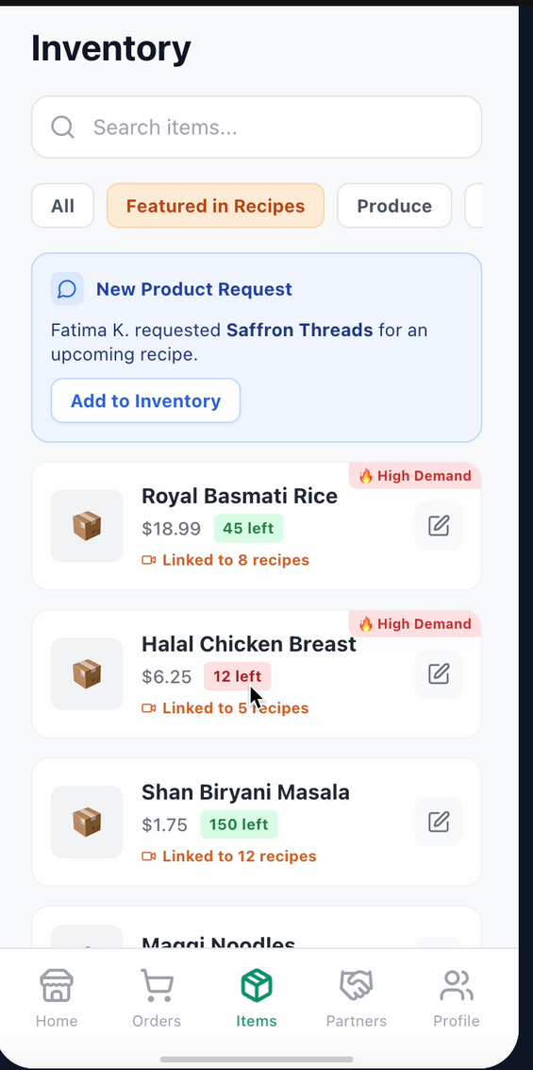

Slide 27



PRODUCT ROADMAP
 | 1st Quarter Jan-Mar | 2nd Quarter Apr-Jun | 3rd Quarter Jul-Sep | 4th Quarter Oct-Dec
Version | Version 1.0 MVP Launch | Version 2.0 Community Features | Version 3.0 AI & Monetization | Version 4.0 National Scale
Strategy | Acquistion: Free app, limited in-app purchases | Activation: Focus on ratings & community engagement | Retention: AI personalization & creator monetization | Acquistion: New segment & geographic expansion
Key Features | Recipe discovery feed Dietary filters (halal, vegan, etc.) Delivery integration Creator video upload 10-15 ethnic store partnerships | Recipe & creator ratings Comment sections Save collections Social media sharing Push notifications | AI meal recommendations Creator monetization Cooking mode voice guide Ingredient substitutions | Live cooking sessions Community challenges Multi-language support Store inventory integration Launch in 10 cities
Key Metrics | 500 active users 50 recipes 100 orders 15 partnered stores | 2,000 active users 200 recipes 500 orders/month 80% recipes rated | 5,000 active users 100 monetized creators 2,000 order/month 40% AI-driven orders | 15,000 active users 1,000+ creators 5,000 orders/month $50K monthly revenue
SUCCESS INDICATORS: USER AQUISITION COST < $15 | CUSTOMER LIFETIME VALUE > $150 | PLATFORM COMMISSION: 10-15% | CREATOR SATISFACTION > 4.2/5

Slide 28
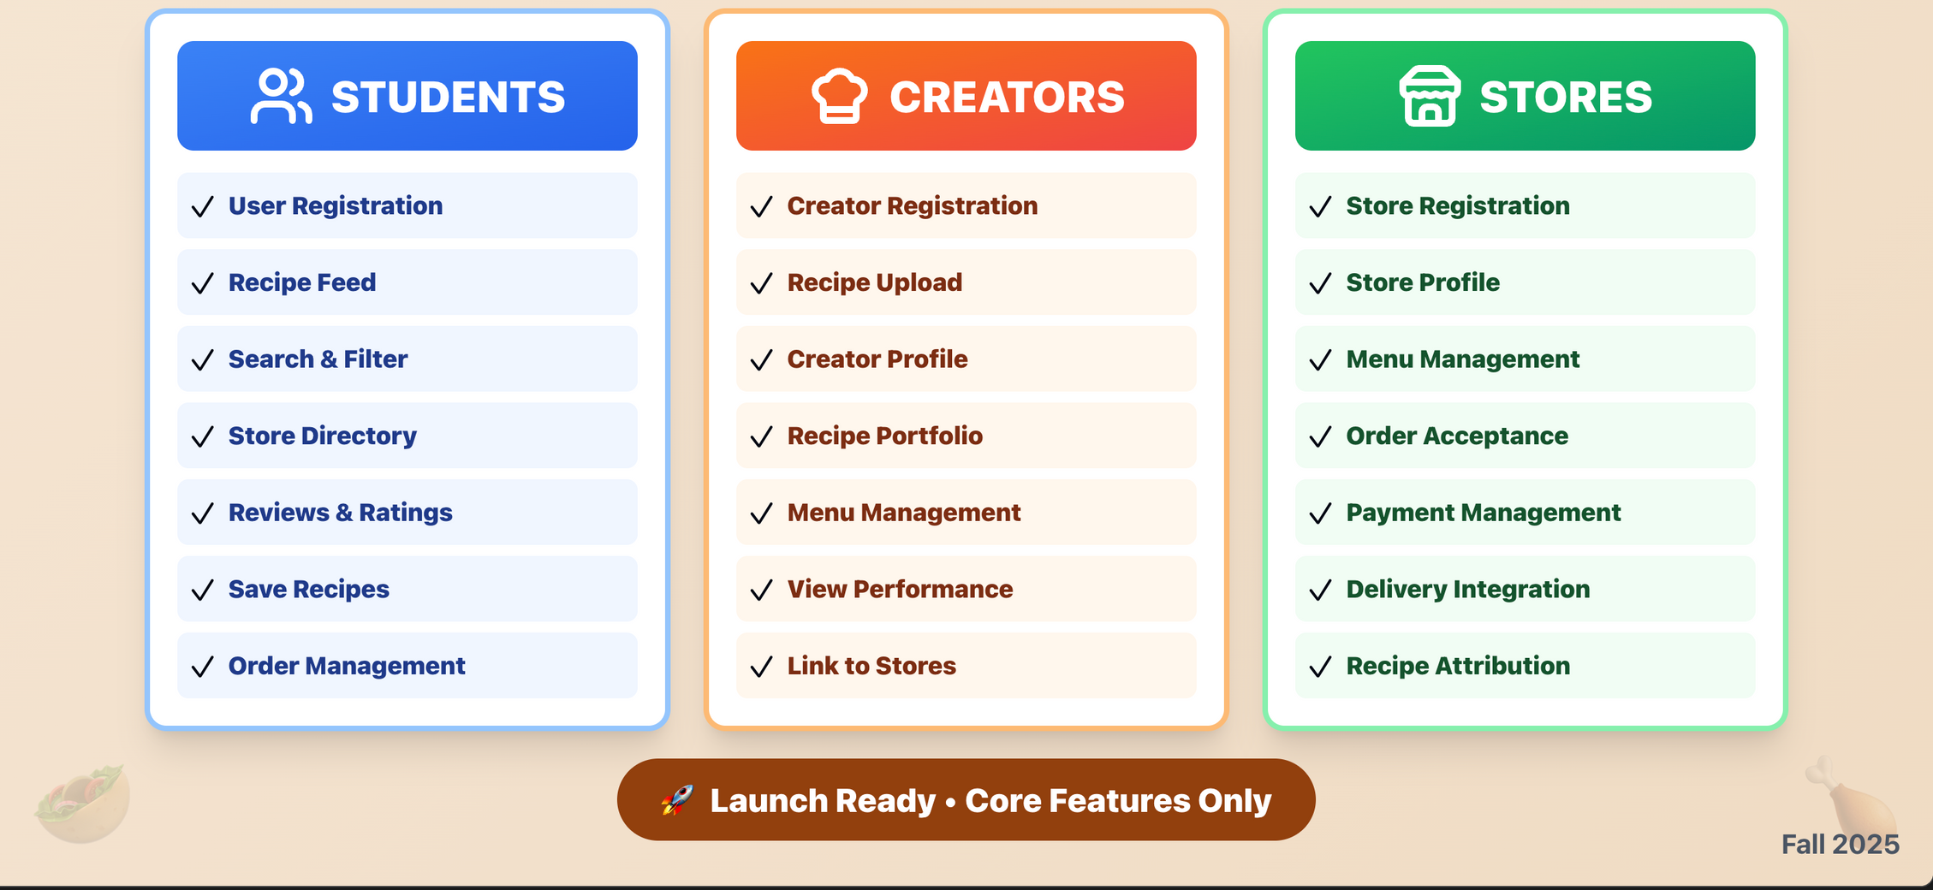
PRODUCT FEATURES (MVP LAUNCH)

Slide 29
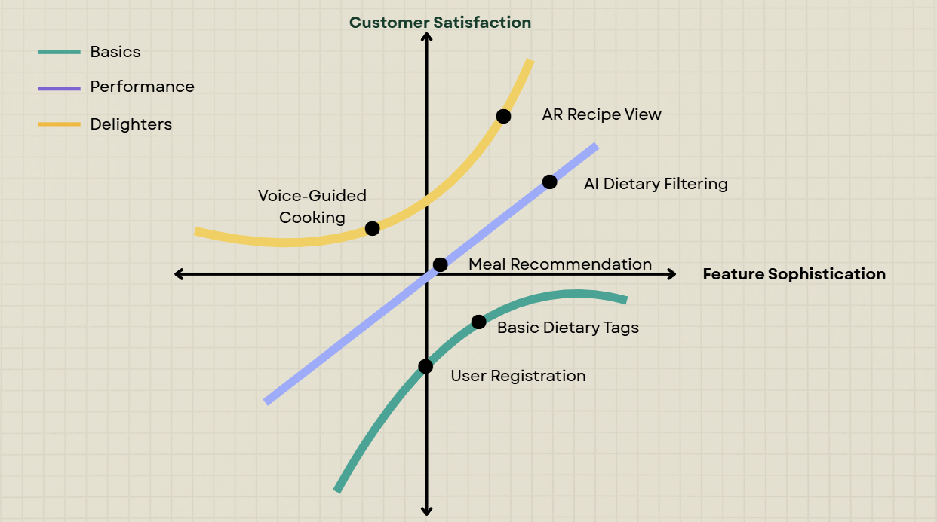
PRODUCT FEATURES
.
Customer Satisfaction
Basics
Performance
.
Delighters
AR Recipe View
.
.
AI Dietary Filtering
Voice-Guided Cooking
.
.
Meal Recommendation
Feature Sophistication
Basic Dietary Tags
User Registration

Slide 30
KEY METRICS
Acquisition
Engagement
How fast users become buyers?
Time to first Purchase
Recipe-To-Cart Conversion
How actively users interact?
DAU/WAU
Recipe Engagement Rate (view→ save/share/favorite/add-to-cart)
Search to Recipe View Success Rate
Creator Upload Frequency
Featured Ingredient Inventory Turnover
Retention
Business
Do users come back?
User Retention Rate (Day 7, Day 30)
Repeat Purchase Rate (30-Day)
Is the marketplace making money?
Average Order Value (AOV)
Order Completion Rate
Partnership-Driven Order Percentage
Creator Monthly Earnings Growth
Ingerdient Promotion Success Rate

Slide 31
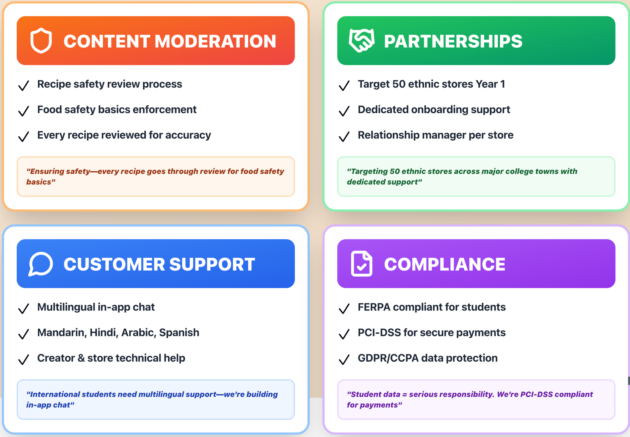
OPERATIONAL NEEDS

Slide 32
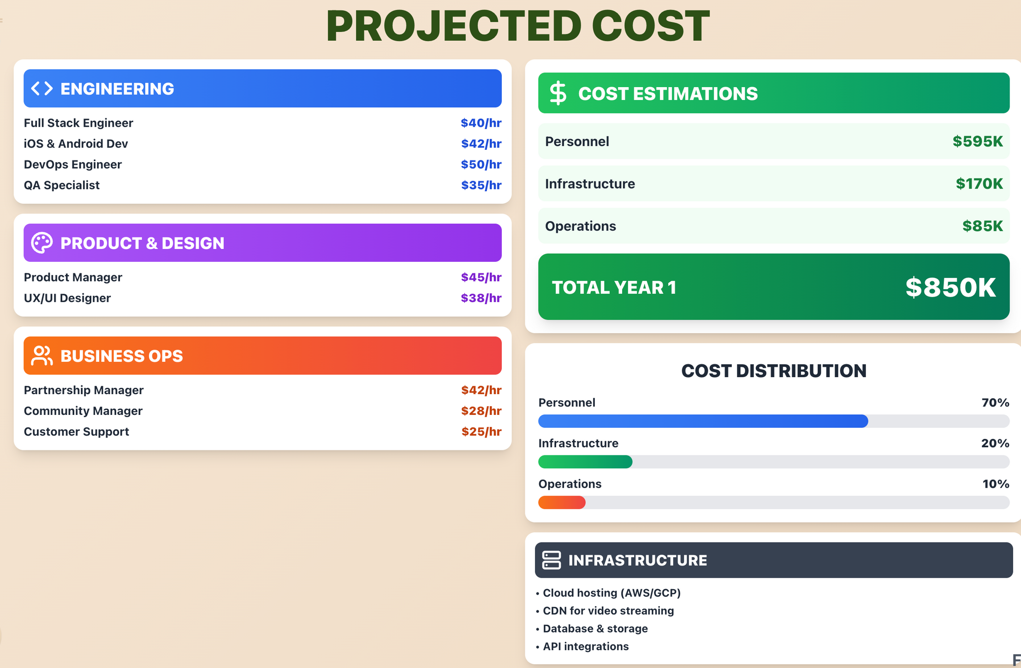
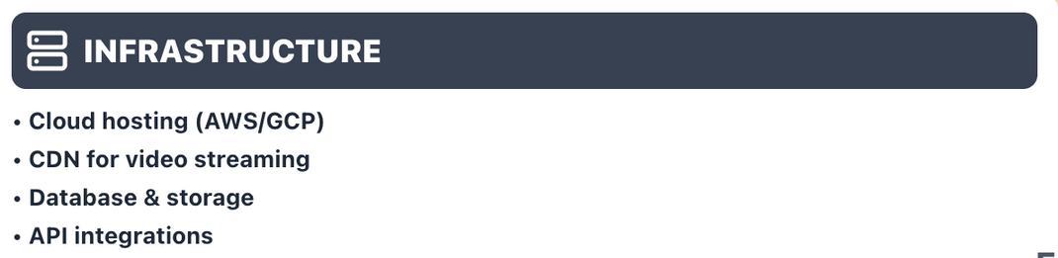
PROJECTED COSTS

Slide 33
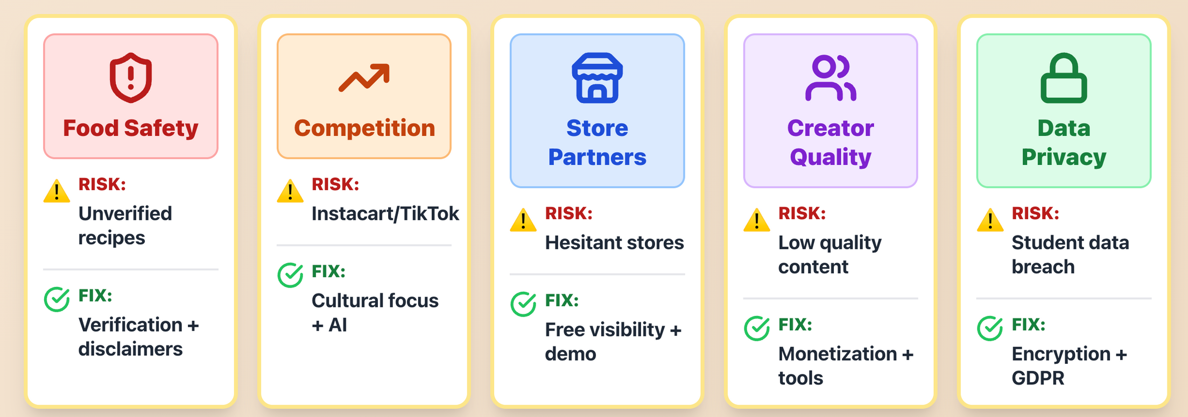
RISKS AND MITIGATIONS

